Slide 1
Brillio Ad Detection
Kevin Chang
Perana Patil
Daisy Yang

Slide 2
AGENDA
Business
Problem
01
Our
Solution
02
Future
Improvements
03
How do we help marketers?
Overview of our methodology and model?
How could our project be expanded?

Slide 3
Business Problem

Slide 4
Business Problem
Companies spend many millions to show their logos during sporting events.
Traditionally, there are a few good ways to quantify the effects of sponsorships.
Both ad buyers and sellers do not know if current ad pricing is too high or too low.

Slide 5
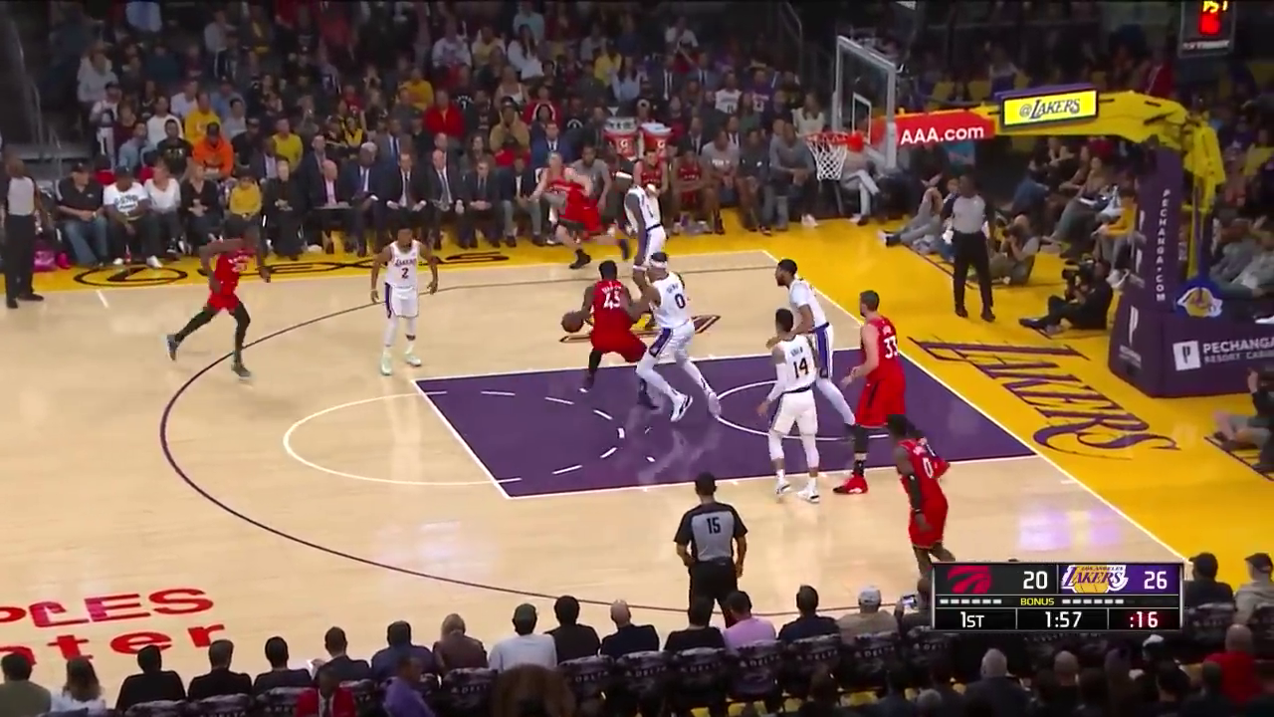
Is this working for you?

Slide 6
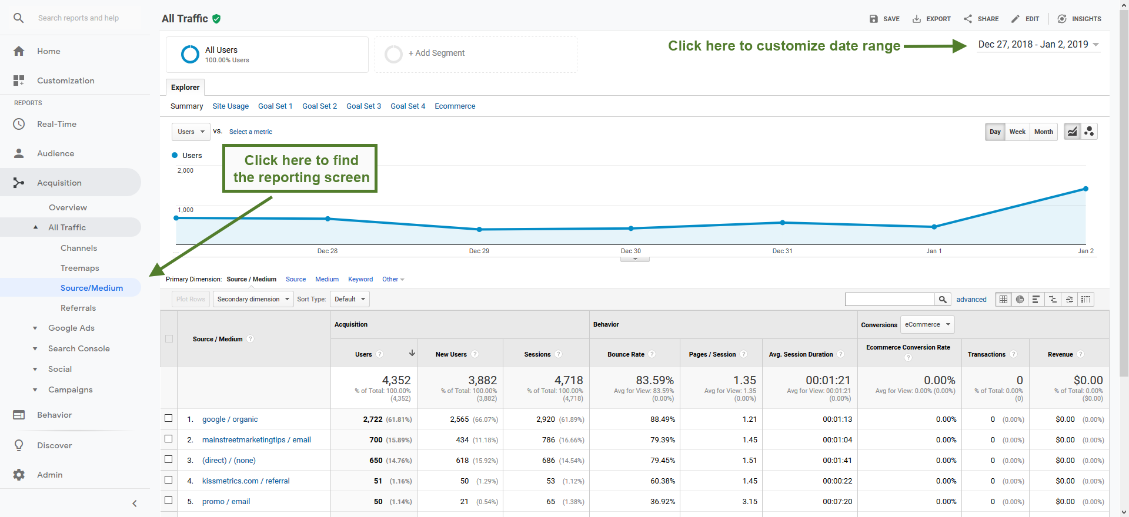
Compare with
Web Marketing

Slide 7

Our Solution
Build a Deep Learning Model with CNNs to quantify logo exposure during a sports broadcast.
We can now know how effective displaying a logo during a game really is.

Slide 8
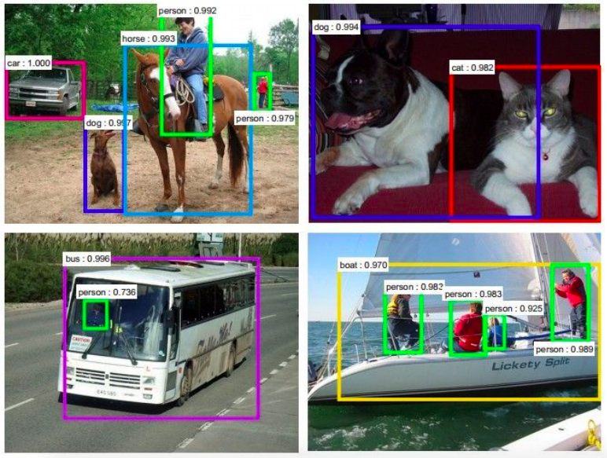
Using Convolutional Neural Networks
ConvNets
are
everywhere.
Notes:
It’s also know as a CNN or ConvNets.
So far it’s been most popularly used for analyzing images.

Slide 9
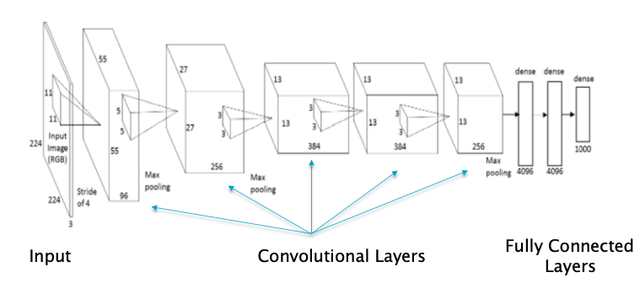
What are ConvNets?
A Convolutional Neural Network (CNN/ConvNet) is neural network with some convolutional layers.
A convolutional layer has a number of filters that has convolutional operations.
Notes:
CNN: an artificial neural network that has some type of specialization for being able to detect patterns and make sense of them( useful for image analysis)
What differentiate it from standard multi-layer perceptron: a CNN has hidden layers called convolutional layers (make CNN a CNN)
And within each convolutional layer: need to specify the number of filters the layers should have. These filters are what exactly can detect patterns.

Slide 10
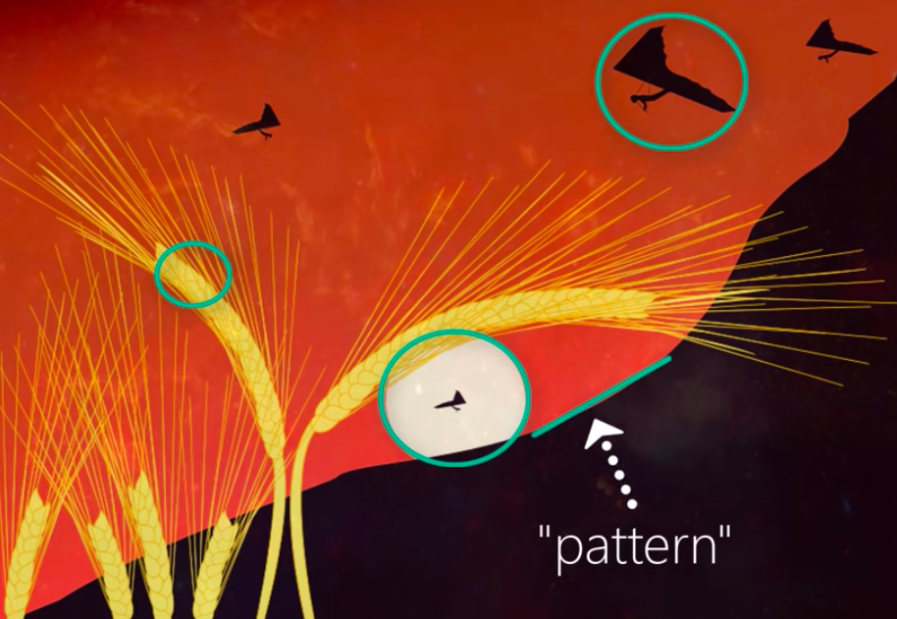
Detecting Patterns
Notes:
Any single image: multiple edges, shapes, objects, etc
“Pattern” that a filter could detect could be edges (this filter would be called edge detector)

Slide 11
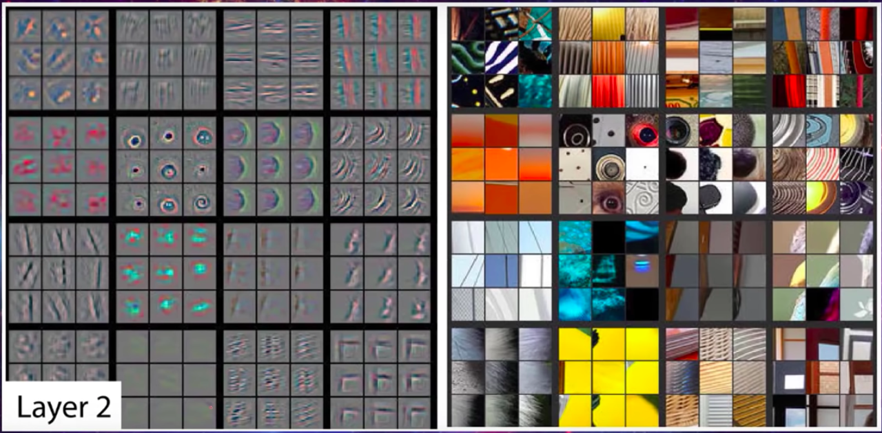
Start layers: basic pattern
Notes:
Some filters may detect corners ( circles, squares)
These simple and basic geometric filters are what we can see at the start of our network.
See: Shapes on the left which are detected from images on the right.
Red one detect circles and Green one at the bottom is detecting corners.

Slide 12
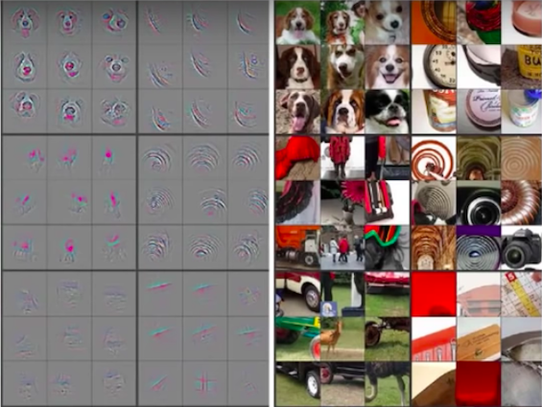
Deeper layers:
detect more sophisticated objects
Notes:
More complicated filters would be located deeper in the network & would gradually detect more complex patterns shown here

Slide 13
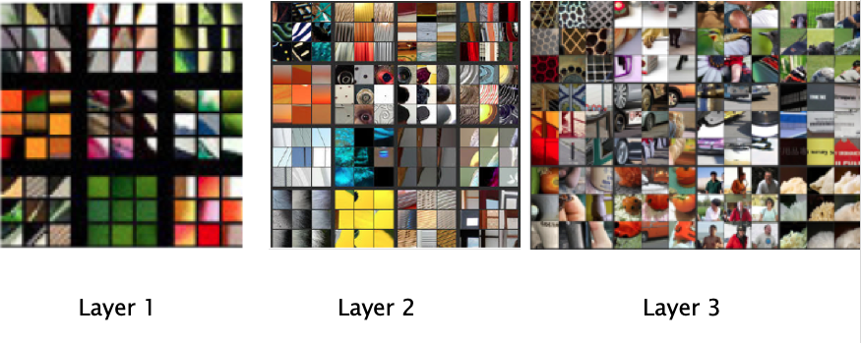
Notes:
They would gradually detect more complex patterns shown here :like peoples or cars

Slide 14

Project Steps
DEFINE SCOPE
GATHER DATA
BUILD AND TRAIN
TUNE MODEL
TEST MODEL
DEPLOY MODEL
Logo detection in NBA Games
Gather NBA footage with StateFarm logo
Build and train a CNN model
Adjust parameters to maximize accuracy
Test model to check accuracy
Use model to predict new videos
Notes:
Now that we have understood how CNNs work lets see the steps we followed for our project.
First was to define the scope of the project. Since ours was an open ended question it was important to define what we can and cannot do at the very begining. The next step was to gather data. Youtube was our main source of data collection. We focused on NBA game highlights videos with Statefarm logo.
Then we built and trained the model. We then fine tune our model to maximize accuracy. We then proceeded to test our model on a completely different video. The final step would be to deploy the model on the client side.
Why did we chose to go ahead with NBA games and Statefarm logos. Our main source for data gathering was YouTube and it had a lot of footage on NBA game highlights. Also NBA games are heavily sponsored so that gave us variety. Statefarm was one of the sponsors for a lot of the Lakers games so we knew we could find additional images later if required. So we stuck to that.

Slide 15
Data Preparation
Logo
Train
Validation
Test
YouTube clips were downloaded and converted to frames
Split labeled data into Train, Validation and Test sets.
No Logo
Train
Validation
Test
Manually label data as having a logo or not.
Notes:
Lets understand the data preparation process. We first downloaded different videos of NBA games. Then we manually cut the videos into frames and labelled them as frames with logo and frames without logo. Then the entire dataset was divided into subsets of Train, Validation and Test. The distribution of this was 80% Train 10% Test and 10% Validation.

Slide 16
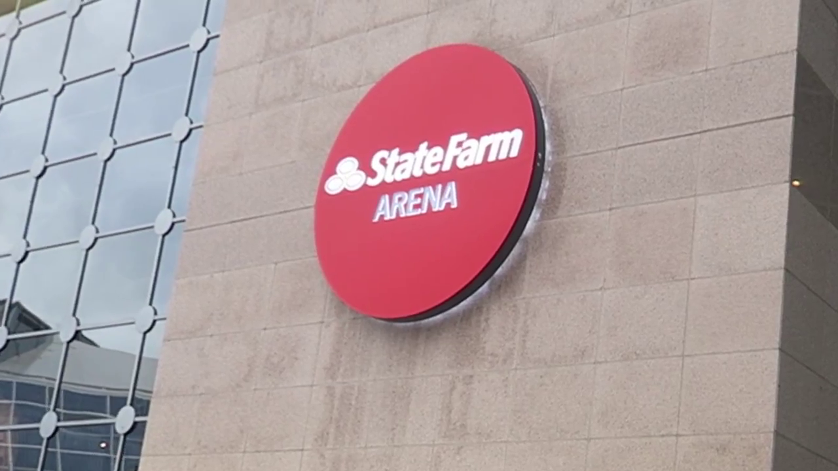
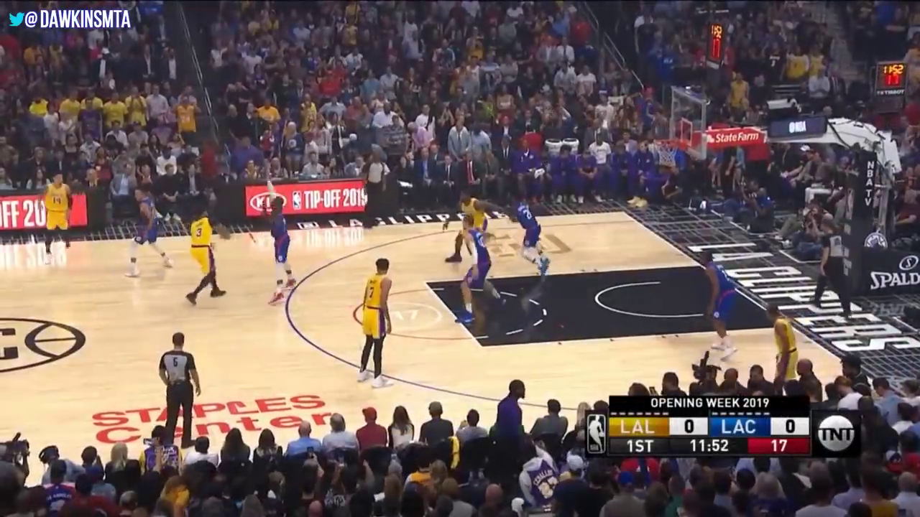
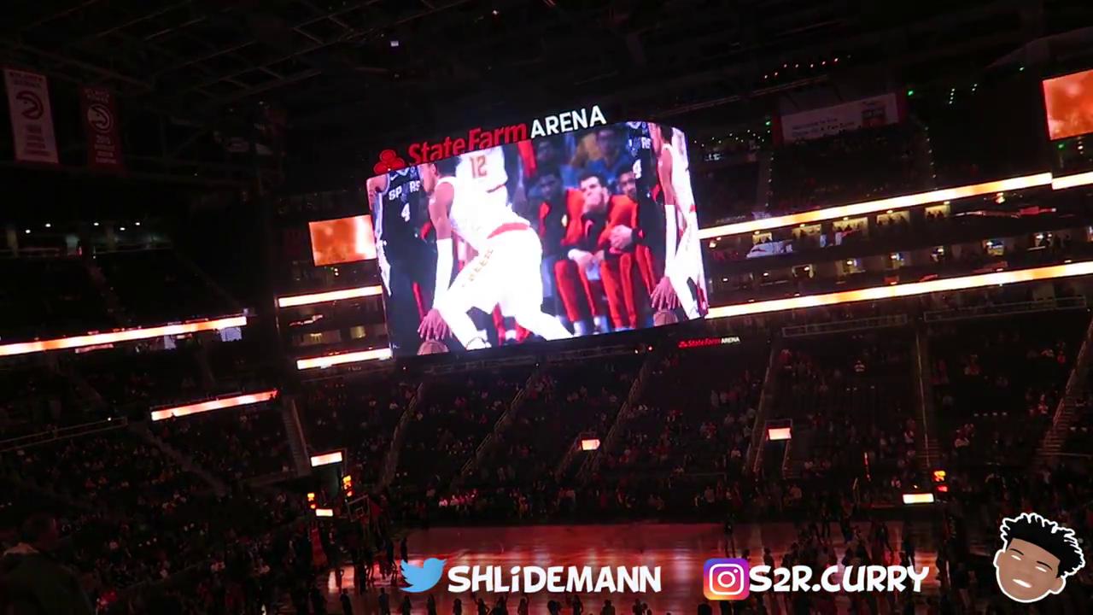
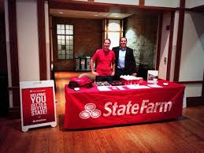
The Dataset
Sample Images with Logo
Notes:
Here are a few examples of the different frames present in the training dataset. It was important to include many different images of the logo so that the model learns as much as possible from the train dataset. So we added images of statefarm logo in different shapes, sizes and depth.

Slide 17
Our Process
Model Training & Tuning
Calculate Logo Exposure
Adding/deleting layers to CNN based on previous results.
Calculate display time based on the results of classification.
01
02
03
04
Prediction
Determine Success Rate
Perform classification on new video clip.
Compare display time with other metrics like Ad spends to calculate ROI.
Notes:
Now I will explain more about the model training and tuning process. We were aiming for an accuracy of 90% and we kept tuning our model to achieve this desired accuracy. We did that by adding and deleting layers in our CNN. We were able to achieve the accuracy of 88% which we think is pretty good as well. The next step was to predict using the model. For this we downloaded a new video clip. Our program then cut the video into frames. From every second it generated 2 frames and then classified the frames as frame with logo and without logo.
The final step for us was to calculate the logo exposure which we did by calculating the time the logo was seen based on the result of our classification. We can then determine the success rate by comparing this display time with ad spends to calculate with ROI.

Slide 18
Final Results
=
Frames with logo
Total Frames
Logo Exposure in %
X 100
=
Frames with logo
2*60
Display Time
 | Duration | Frames (2 frames per second) | Frames with logo | Exposure % | Display Time
Video 1 | 9:46 mins | 1172 | 940 | 80.02 | 7.83 mins
Video 2 | 1:45 mins | 210 | 57 | 27.14 | 28.5 secs
Notes:
Here are two examples of the results. One which as 9.45 mins long and the other was relatively small for about 2 minutes. From these videos the program generated about 1172 and 210 frames and for each video classified 940 images with logo and for the second video 57 frames had logo. From these results we could calculate exposure at 80% for the first video which means from 9.45 mins mpre than 7 mins the logo was displayed. For the second video exposure was 21% where the logo was seen for only 28 secs.

Slide 19
Business Applications
Determining Return on Investment
Determine Best Locations
Now that ad buyers can know how long and ad can be seen, they can decide if certain spots are worth the price.
Using the model, marketers can now quantify what locations get the most screen time.

Slide 20
FUTURE EXPLORATIONS
MULTIPLE LOGOS
REAL-TIME DETECTION
OTHER
SPORTS
Improve model to detect multiple logos instead of one.
Use techniques like YOLO for real time object detection.
Expand the project to other sports broadcasts and events.

Slide 21
THANK YOU

Slide 22
QUESTIONS?

Slide 23
APPENDIX

Slide 24
Defining the Scope
Focus on NBA Games
Focus on Statefarm logo
Video footage is widely available on Youtube
Clearly visible Logos on all sides of the court
Focus on 9 min highlight videos
Logo is distinct and easy to recognize
Can easily find additional training images
Notes:
Cut Slide

Slide 25
Data Gathering
1. Find Videos
2. Download Videos
3. Convert To Frames
4. Label Data
5. Data Storage
Searched for NBA highlight videos on YouTube
Download highlight videos as MP4 files
Convert videos to a series of images using VLC media player
Frames segregated as with logo and without logo and divided into train, test and validation datasets.
Labelled Dataset uploaded to Google Drive for easy access and use.
Notes:
Cut Slide. Kept here for reference

Slide 26
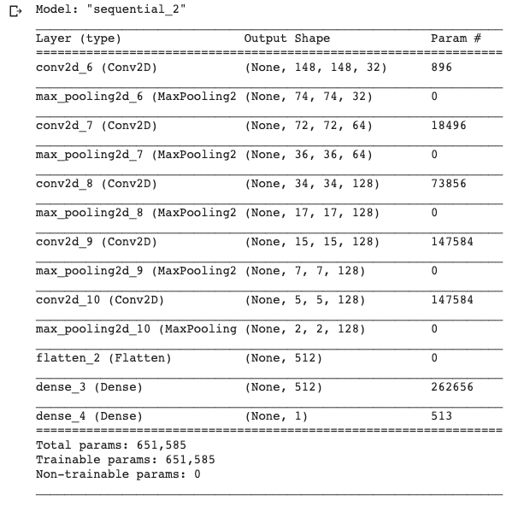
Model Layers

Slide 27
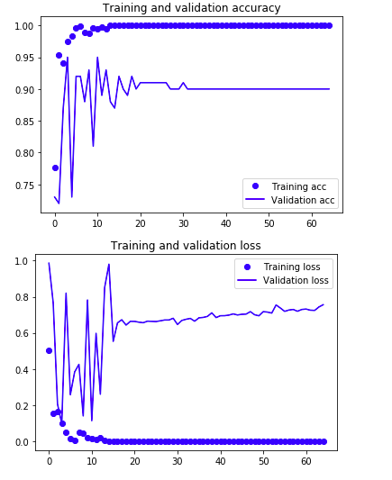
Model Results

Slide 28
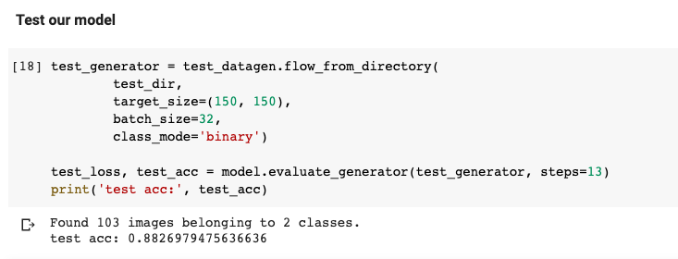
Model Test Results

Slide 29
THANKS
Special thanks:
Brillio (www.brillio.com)
Subir Varma – Faculty Advisor
Please keep this slide for attribution.

